Slide 1
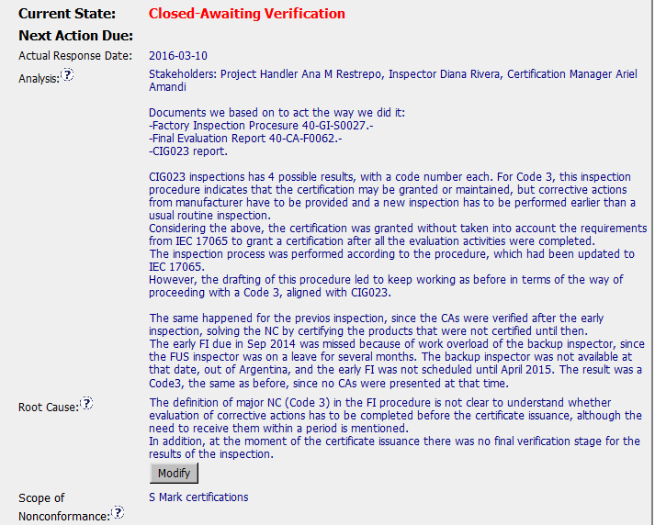
Stakeholders are identified and clear (i.e., responsibilities /titles)
It is not clear what happened – was the FI SOP changed to address 17065 requirements? That is the issue identified in the CAR non-conformance – but it seems that the SOP remains aligned with CIG023 and does not fulfill 17065 requirements? If so - this is a major concern as it is not possible to prevent future recurrence if the FI SOP does not meet 17065 requirements for certification.
It is not clear enough as to whether or not the FI SOP has been revised – there are mentions of a revision in the verification milestone, but no objective evidence is shown.
Requirements are clearly identified and described
Good analysis information – as it includes historical information that helps to define the scope of the issue.
Root Cause is unclear. It seems that the FI Procedure and 17065 have different requirements based on the analysis – however the root cause does not describe WHY.

Slide 2
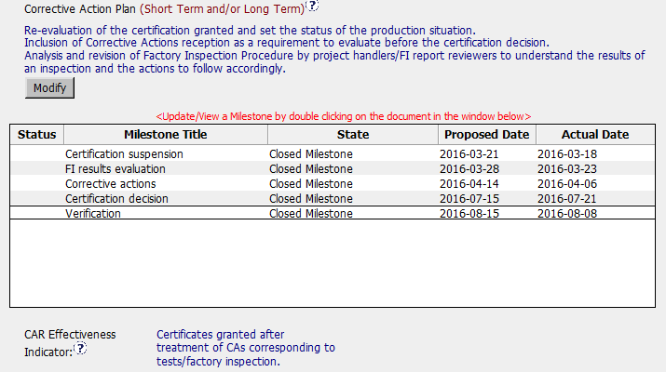
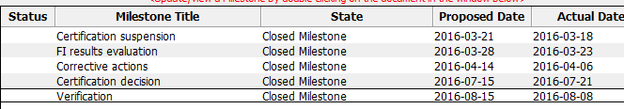
If the FI SOP and 17065 are not consistent – a revision should have been made to the FI SOP – was this done? No actions taken to address this are listed in the Corrective Action Plan or milestones. (Even an ‘action already taken’ can be listed in the Corrective Action Plan.)
Actions taken in the Corrective Action Plan address containment – but they do not address the disparity in requirements or the root causes.
Actions were taken swiftly to address the certifications, they conducted a review of similar certifications (containment) and appropriate action was taken to rectify the situation with UL’s affected customers for the cited project and those found during the scope investigation.

Slide 3
Root cause is not accurate – but the actions taken do address containment and recurrence (assuming the FI SOP meets 17065 requirements)

Slide 4
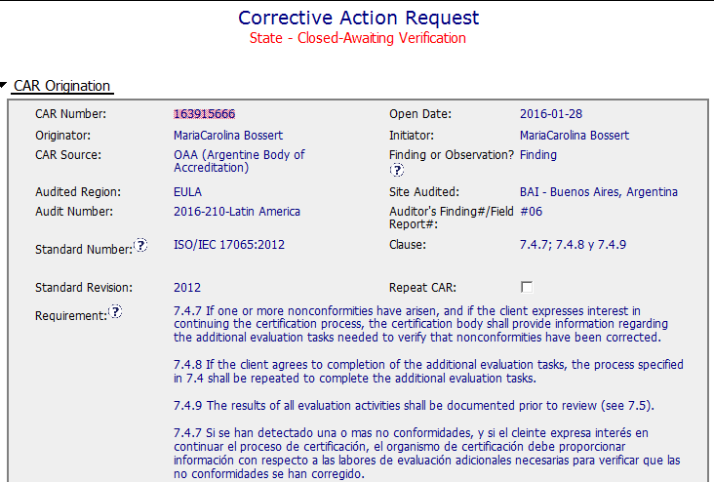
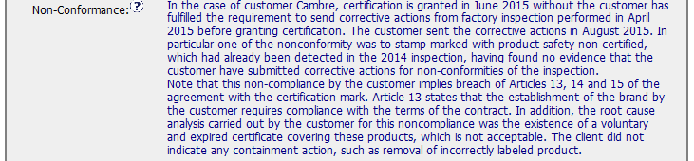
CAR 163915666
Finding - CAR

Slide 5
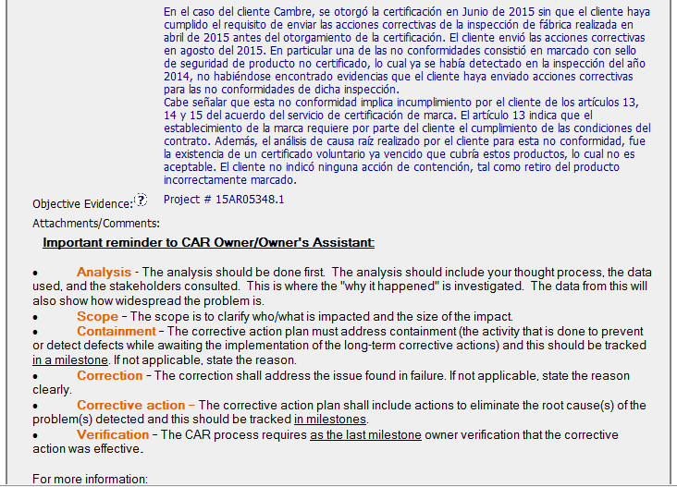
CAR 163915666
Finding - CAR
Excellent
CAR Admin (same one as originator) translated the language from Spanish(?I’m not sure) to English.

Slide 6
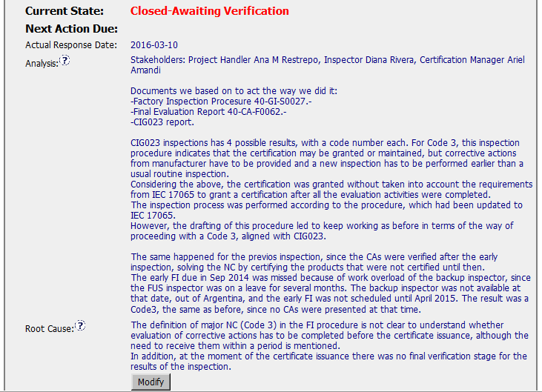
CAR 163915666 Analysis
Excellent
Analysis:
Stakeholders were documented.
Documents related this CAR were identified.
The previous works have been analyzed
Excellent
Root cause statement is succinct, reasonable, complete

Slide 7
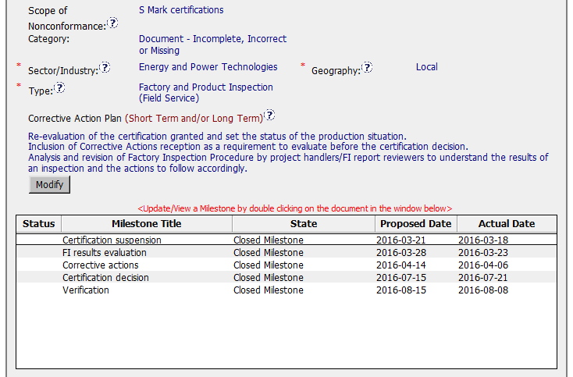
CAR 163915666 Corrective Action
Excellent
Action Plan fix nonconformance and root cause
Need Improvement
5 Milestones just address part of root cause and corrective action plan, no milestone for the revision of Factory Inspection Procedure, please see detailed milestones on next slides
Note
Proposed date interval between milestone 3&4 should be set up less than 2 months, like this case, one more milestone is suggested to add. However, when I check the CAR History, I found it is caused by implementation date extension.

Slide 8
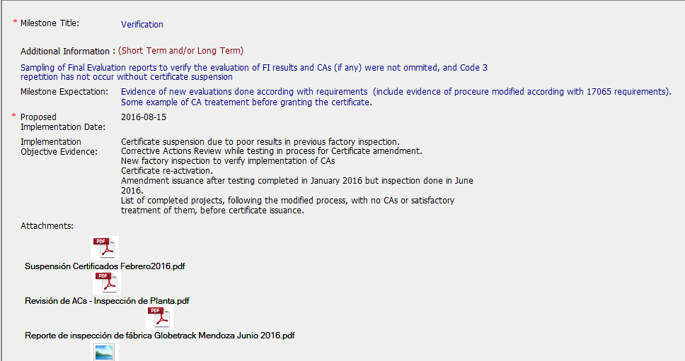
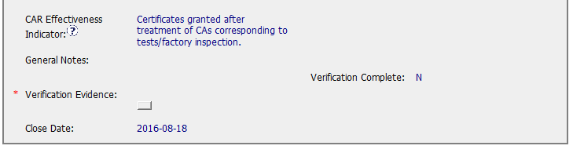
CAR 163915666 Milestone 5 Owner’s Verification
Need Improvement
All 5 Milestones just address part of root cause and corrective action plan, no milestone for the revision of Factory Inspection Procedure, CAR Admin has identified the milestone expectation to reminder CAR owner to provide the evidence of procedure modified according to 17065 requirements, but CAR owner didn’t provide it.
CAR owner’s verification not completed per milestone expectations
Note
The CAR stays at its “Closed-Awaiting Verification” status, so it’s reasonable for the CAR admin not to complete the verification action.

Slide 9
CAR 163915666 – CBS Check
CBS Requirements | Excellent | Moderate | Need Improve | N/A
(C) Extensions are within requirement (<30 days, 3 or less) | √
(T) Most appropriate ‘category’, ‘type’, ‘geography’ are selected | √
(P) Facilitates the handling of disputed CARs |  |  |  | √
(T) Acts on CARs within required timeframe | √
(C) Analysis shows clear path to root cause and scope; stakeholders identified | √
(C) Root cause statement is succinct, reasonable, complete (Shows ‘N/A’ for observations) | √
(C) Corrective actions fix the objective evidence and other problems found; address entire root cause and scope. For observations, they do not go beyond fixing the objective evidence |  |  | √
(C) Milestones address containment & owner’s verification; completed per milestone expectations |  |  | √
(P) Verification per requirements |  |  |  | √
(L) Referenced communications are attached as needed | √
(C L) Evidence of communication for overdue/escalated CARs and other pertinent concerns | √
(P) Trains other CAR Champions |  |  |  | √

